Slide 1





Raman Laser system
Amplifying and locking the Raman laser beams for gravimeter atom interferometry
ESPCI
PARIS

Slide 2

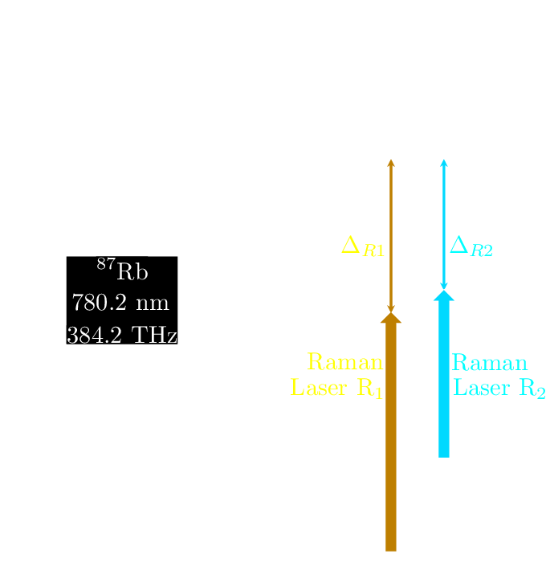
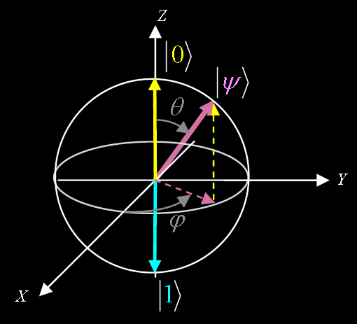
1-Raman lasers

Slide 3
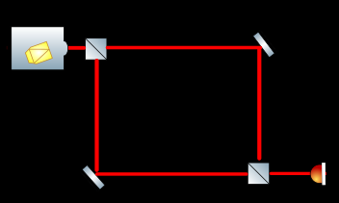
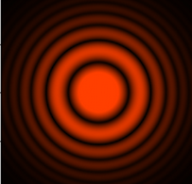
2-Mach Zehnder Interferometry
I(Δφ)=Imax cos²(Δφ/2)

Slide 4
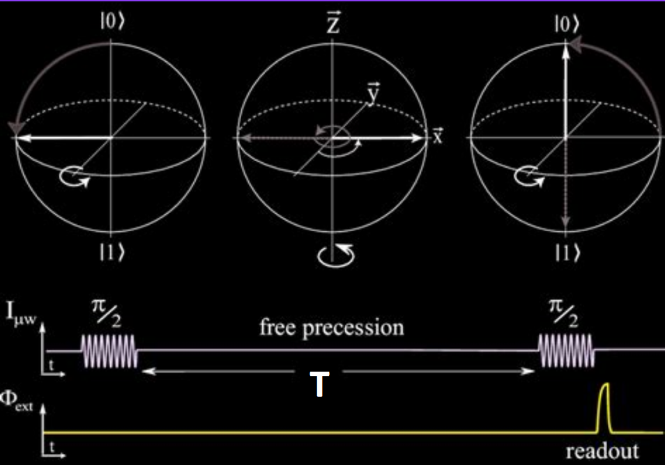
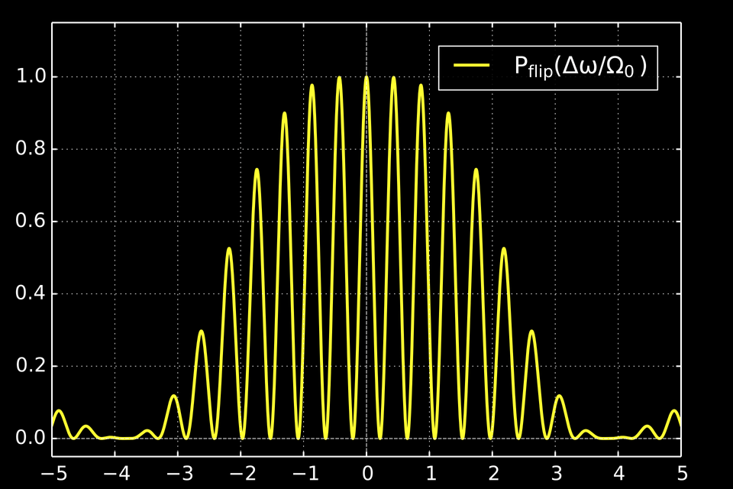
3-The Ramsey interferometry
T is the interrogation time
Δ=ω-ω₀ is the detuning
P₁(T,Δ)=cos²(Δ*T/2)

Slide 5
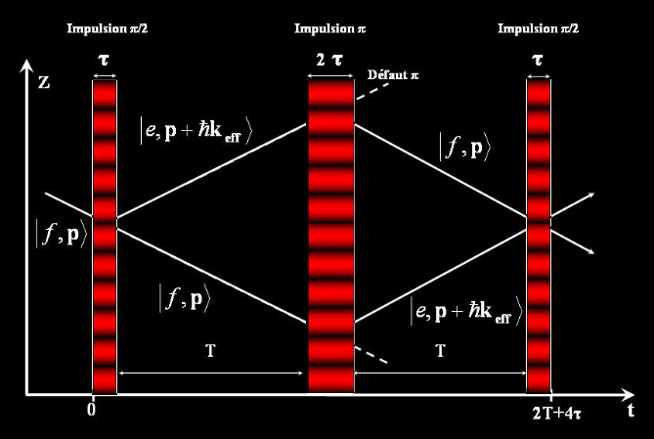
4-Atom Interferometry for gravimetry
Δφ=k eff · Δx
Δx=gT²
Pe(2T + 2τ ) = 1 − A cos(g · k eff T²)²

Slide 6
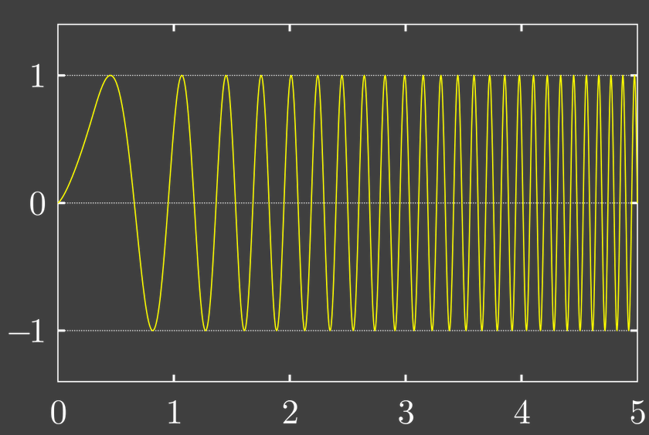
5-Getting a value for g
Chirp
Pe(2T + 2τ ) = 1 − A cos(g · k eff T²+(2πa·T)·T)²
a is the chirp rate
it’s equivalent to changing the detuning Δ with time in the Ramsey interferometer.
T(interrogation time)

Slide 7
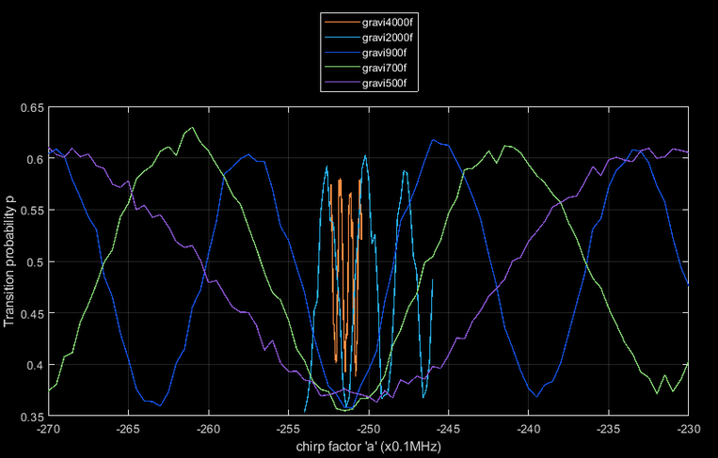

6-Gravimetry results
g · k eff=-2πa

Slide 8
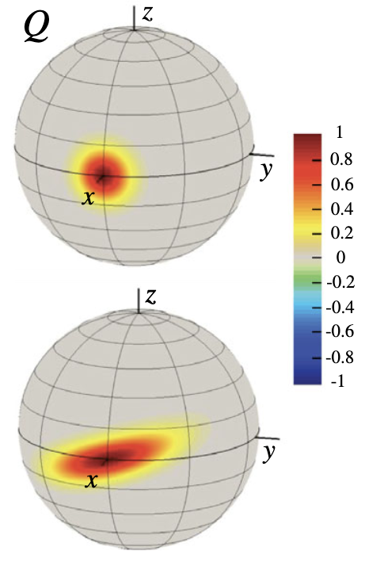
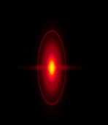
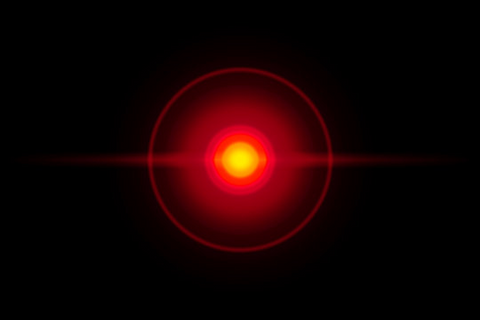
7-Squeezing
Uncertainty Principle
∆X∆P ≥ ℏ/2
Coherent state
Squeezed state
X
X
P
P
∆X = ∆P =√(ℏ/2)
∆X > ∆P

Slide 9
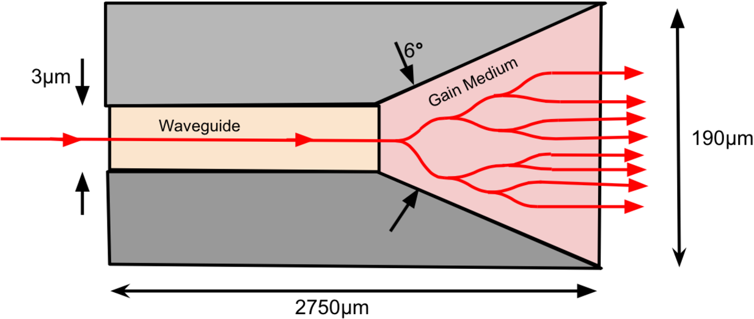
8-The Tapered amplifier

Slide 10
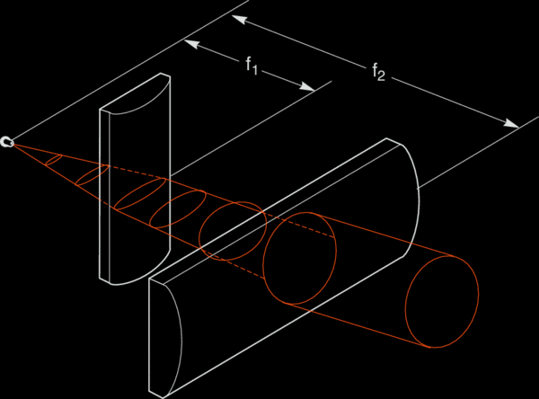
9-Astigmatic output of TA

Slide 11

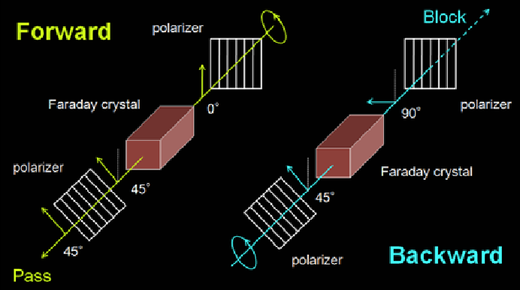
10-The optical isolator

Slide 12
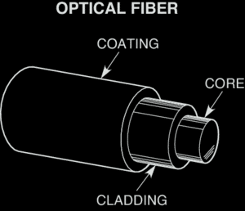
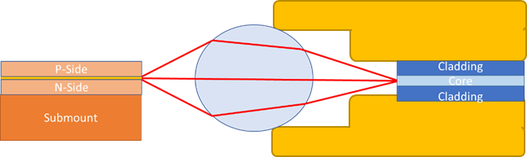
11-Fiber coupling

Slide 13
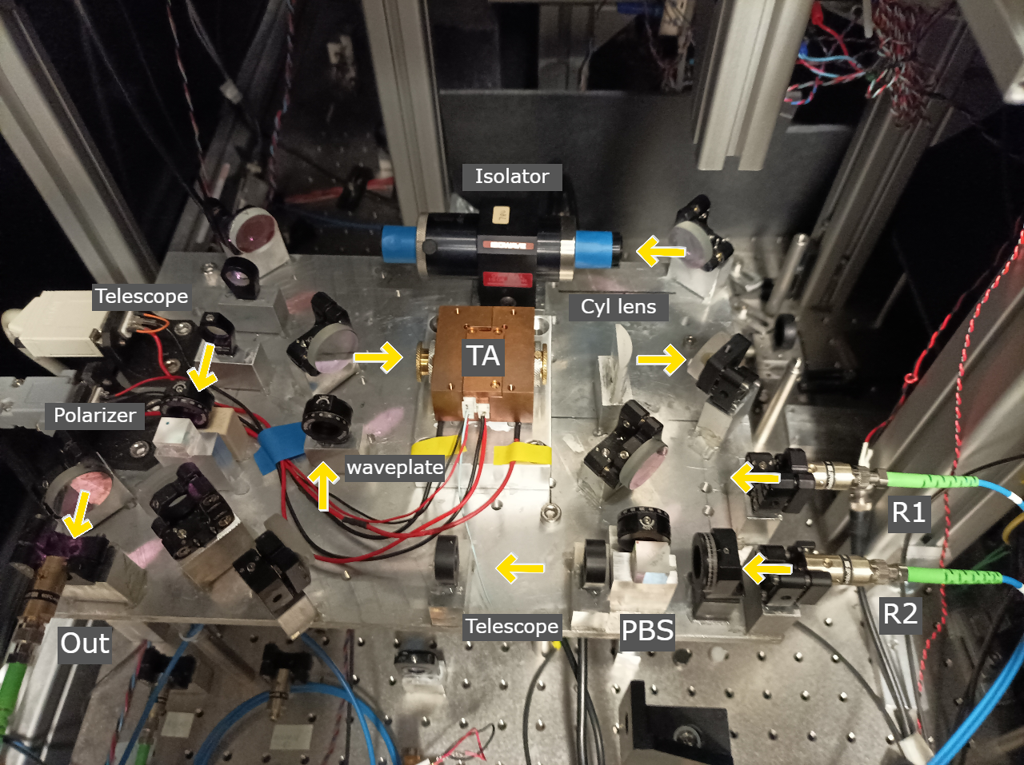
12-The TA’s build

Slide 14
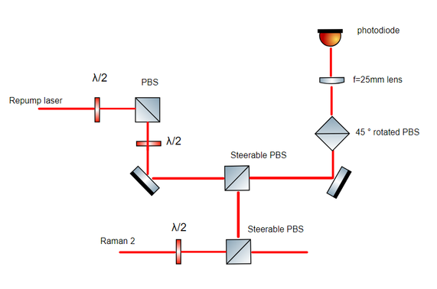

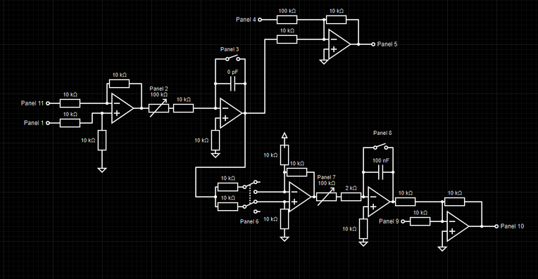
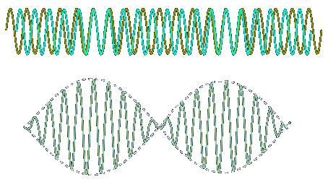


13-The offset lock
Integrator+ double integrator
F to U
R2 laser current and piezo
Repump laser
Raman 2

Slide 15
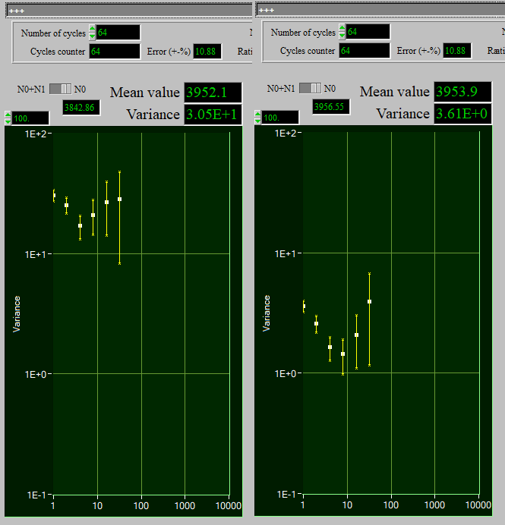
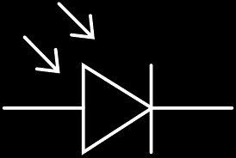
14-Raman laser power lock
photodiode voltage
Integrator
TA current modulation

Slide 16
Thank you for your attention!

